Slide 1
Red Black Tree
NAMAN ANAND
200101070
CSE dept

Slide 2
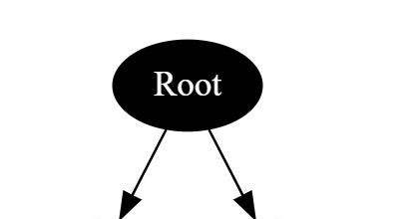
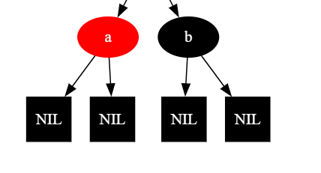
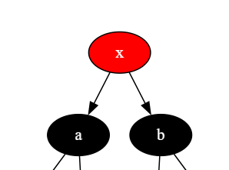
Red Black Tree Properties
Depth Property : Path from node to leaf has same no of black nodes
Red Node : Always have black children
Root : Always Black
Leaf Node : Always Black
The red-black color is meant for balancing the tree.
The limitations put on the node colors ensure that any simple path from the root to a leaf is not more than twice as long as any other such path. It helps in maintaining the self-balancing property of the red-black tree.

Slide 3
Red and Black Tree Use :
why do we require a Red-Black tree if AVL is also a height-balanced tree?
The Red-Black tree is used because the AVL tree requires many rotations when the tree is large, whereas the Red-Black tree requires a maximum of two rotations to balance the tree
AVL tree is strictly balanced, while the Red-Black tree is not completely height-balanced. So, the AVL tree is more balanced than the Red-Black tree, but the Red-Black tree guarantees O(log2n) time for all operations like insertion, deletion, and searching.

Slide 4
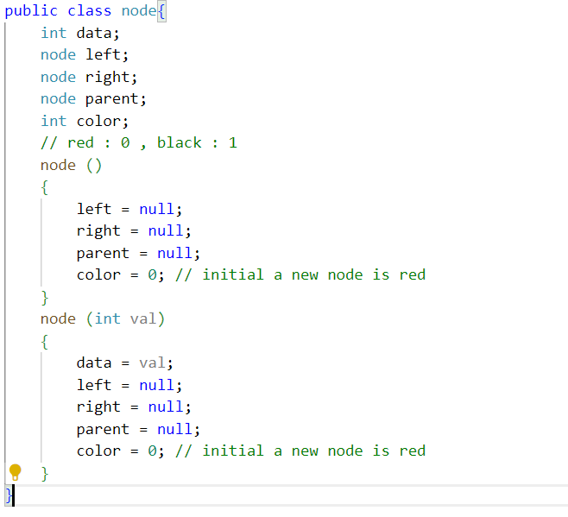
Node
Node Class
Left Ptr
Right Ptr
Parent Ptr
Colour
Data
isLeaf

Slide 5
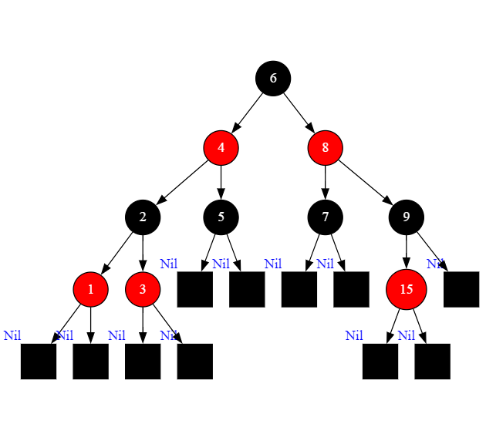
IMPLEMENTATION
We have Two Operations To fix up Red Black Tree
INSERTION

Slide 6
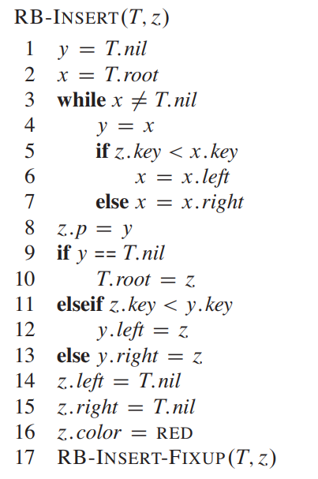
Step 1
ADDITION LIKE BINARY TREE : RED NODE

Slide 7
Step 2
IF IT IS ROOT CHANGE ITS COLOR TO BLACK

Slide 8
Step 3
NOW DO FOLLOWING UNTIL COLOR OF ITS PARENT IS BLACK OR IT IS NOT ROOT
CASES

Slide 9
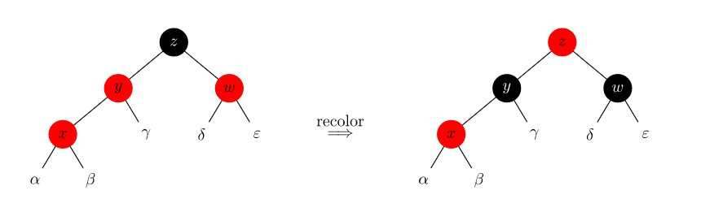
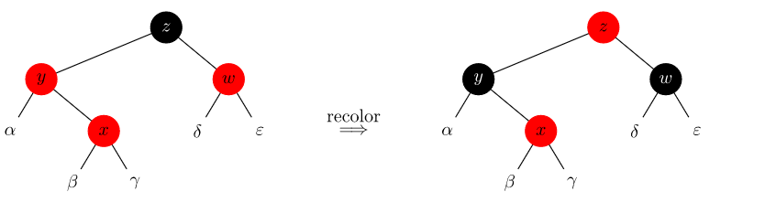
CASE 1
CHANGE THE COLOR OF ITS PARENT AND UNCLE AS BLACK
IF X’s Uncle is Red
CHANGE COLOR OF ITS GRANDPARENT TO RED

Slide 10
CASE 1
4 SUB CASES
Left Left case
IF X’s Uncle is BLACK
Left Right case
Right Right case
Right Left case

Slide 11
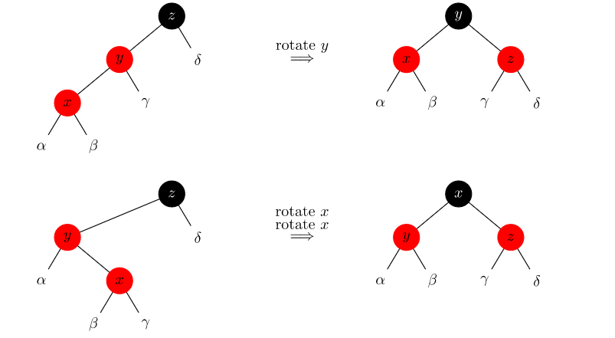
SIMILIARLY DO FOR RIGHT RIGHT AND RIGHT LEFT SUBCASE
LEFT LEFT
LEFT RIGHT

Slide 12
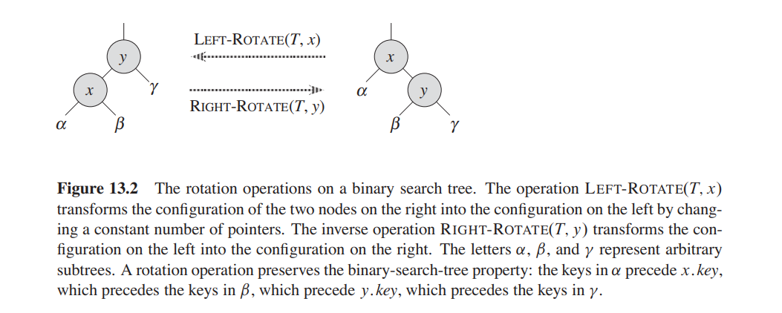
FOR IMPLEMENTATION OF ALL THE SUBCASES WE ARE USING THIS TWO OPERATIONS :

Slide 13
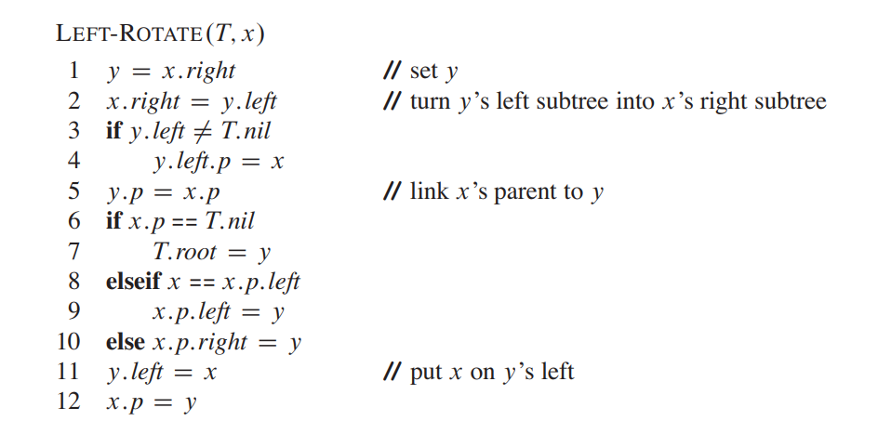
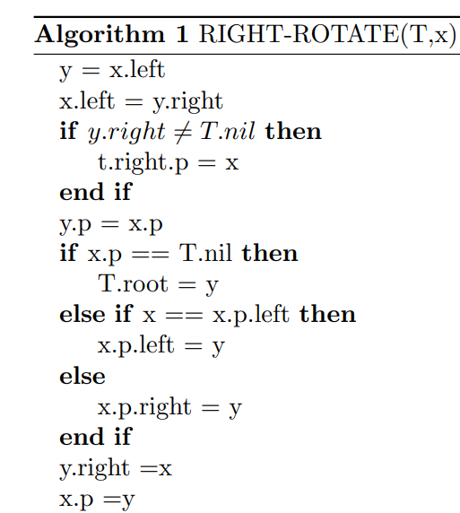

Slide 14
Time Complexity

Slide 15
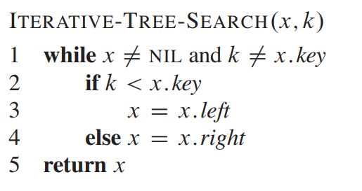
Search in Red Black Tree
Similar to Search in Binary Search tree

Slide 16
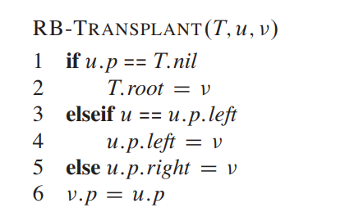
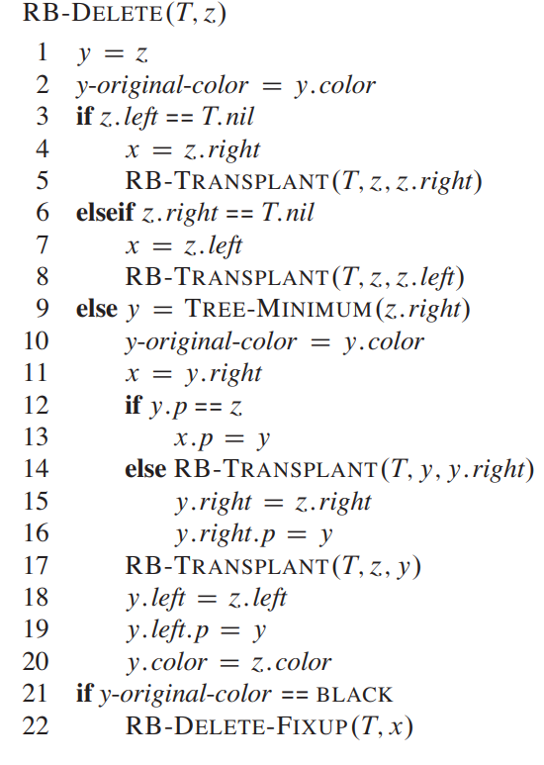
DELETION
To accompany deletion we first introduce a helper function RB-TRANSPLANT which moves the subtrees.
The responsibility of setting v.left and v.right solely depends on caller.
When we want to delete node z and z has fewer than two children, then z is removed from the tree, and we want y to be z. When z has two children, then y should be z’s successor, and y moves into z’s position in the tree. We also remember y’s color before it is removed from or moved within the tree, and we keep track of the node x that moves into y’s original position in the tree, because node x might also cause violations of the red-black properties. After deleting node z, RB-DELETE calls an auxiliary procedure RB-DELETE-FIXUP, which changes colors and performs rotations to restore the red-black

Slide 17
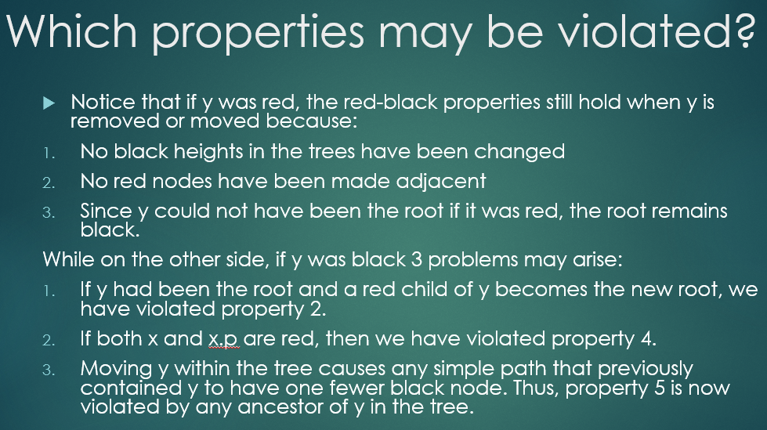

Slide 18
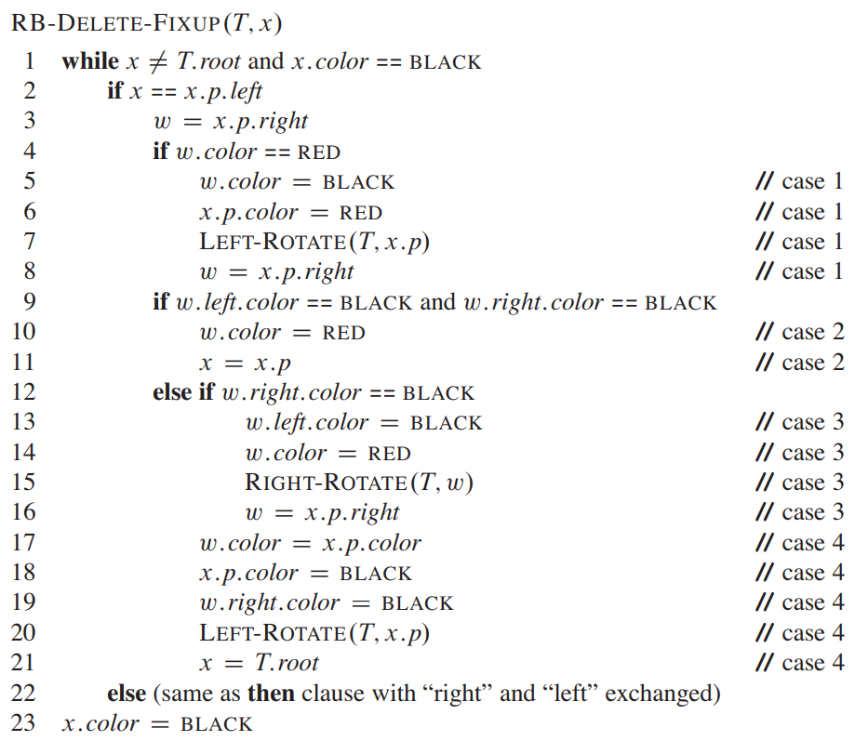
Deletion Fix-up :
It restores property 1,2 and 4. The goal of the while loop in lines 1–22 is to move the extra black up the tree until:
x points to a red-and-black node, in which case we color x (singly) black in line 23
x points to the root, in which case we simply “remove” the extra black;
having performed suitable rotations and recolourings, we exit the loop.
Within the while loop, x always points to a nonroot doubly black node.

Slide 19
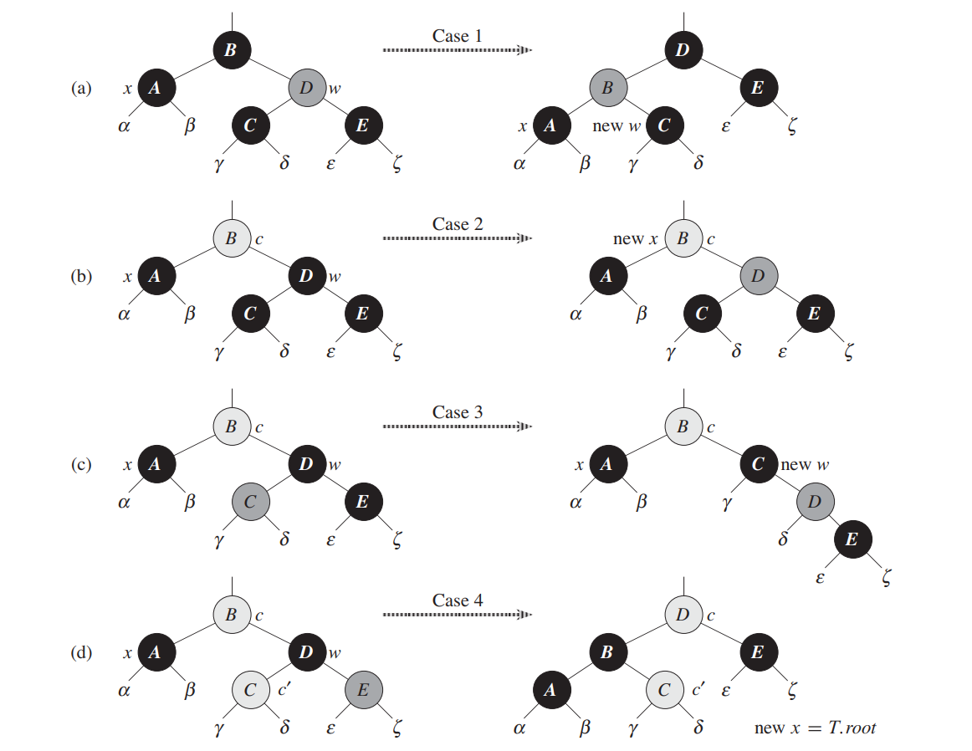
4 CASES :

Slide 20
TIME COMPLEXITY
RB-DELETE-FIXUP takes O(log n) time and performs at most three rotations, and the overall time for RB-DELETE is therefore also O(log n)

